Slide 1
PicHub Mina Amir Girgis
Here is where your presentation begins

Slide 2
Table of contents
01
02
03
04
05
06
Introduction
Features
Tools
Services
Recommendations
Conclusion

Slide 3

01
Introduction

Slide 4

What is PicHub
PicHub is an interactive picture browsing and picture hosting website.

Slide 5
02
Features

Slide 6
Things to include in your portfolio
Registeration
Interactive
User Profile
You can now register and sign in PicHub and all your changes will be saved to your account
You can like, view, comment or report any picture you see.
You can access Your profile page from anywhere and see your aploads and collection

Slide 7
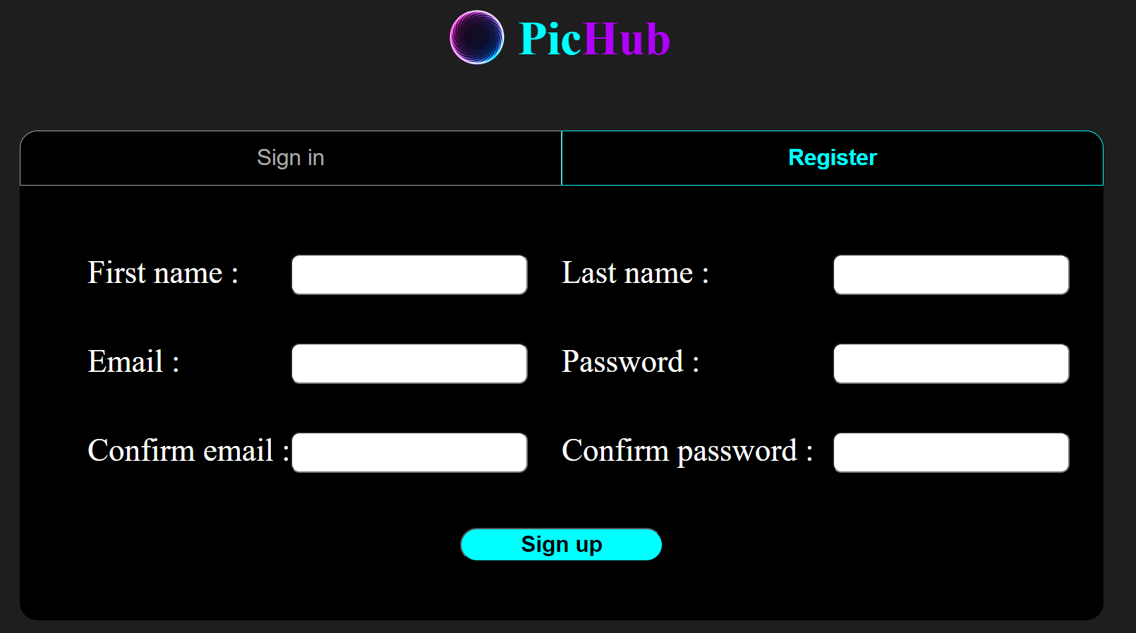
Things to include in your portfolio
Registeration
Interactive
User Profile
You can now register and sign in PicHub and all your changes will be saved to your account
You can like, view, comment or report any picture you see.
You can access Your profile page from anywhere and see your aploads and collection

Slide 8
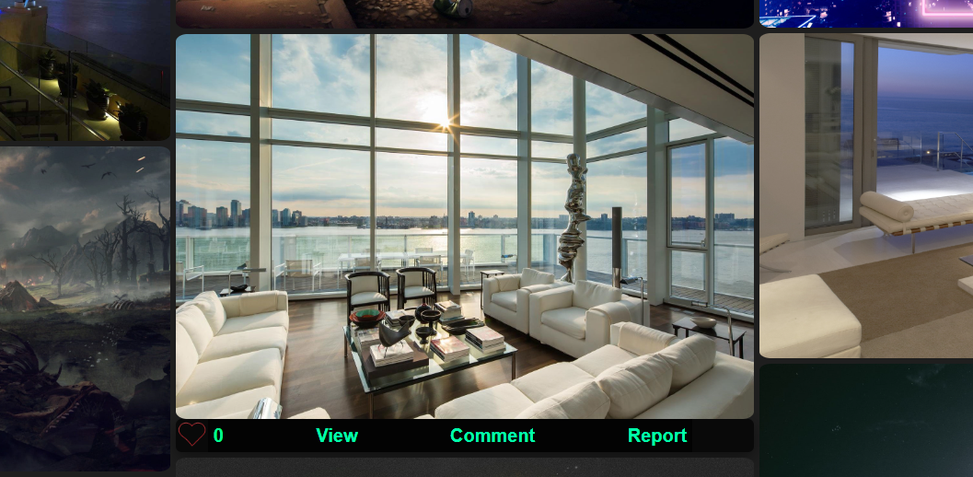
Things to include in your portfolio
Registeration
Interactive
User Profile
You can now register and sign in PicHub and all your changes will be saved to your account
You can like, view, comment or report any picture you see.
You can access Your profile page from anywhere and see your aploads and collection

Slide 9
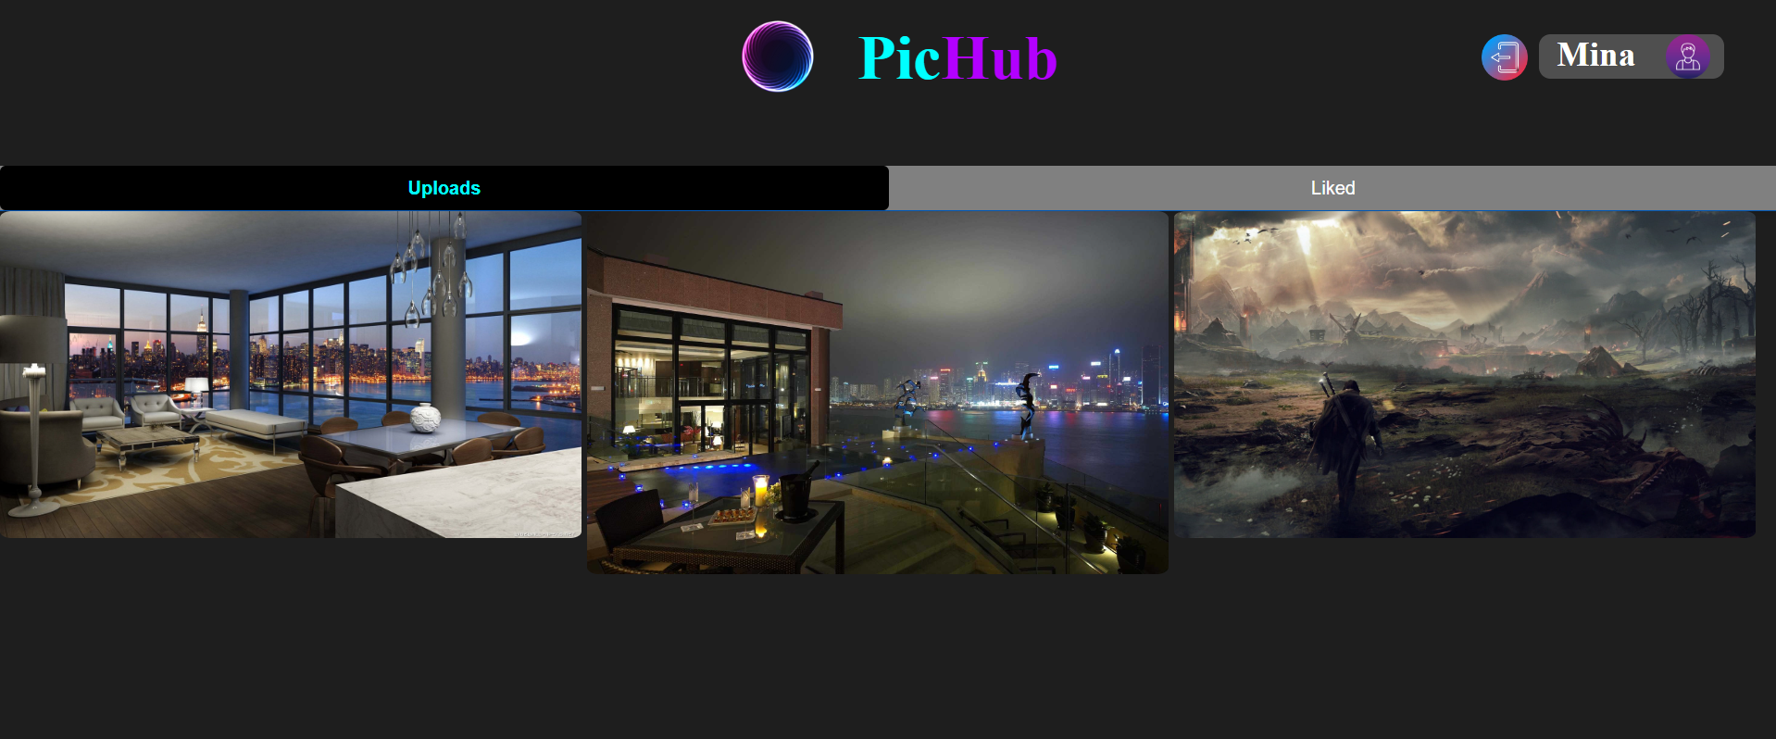
Things to include in your portfolio
Registeration
Interactive
User Profile
You can now register and sign in PicHub and all your changes will be saved to your account
You can like, view, comment or report any picture you see.
You can access Your profile page from anywhere and see your aploads and collection

Slide 10
03
Tools

Slide 11
Previous projects
React
Node.js
For the website frontend
For the website backend

Slide 12
04
Services

Slide 13
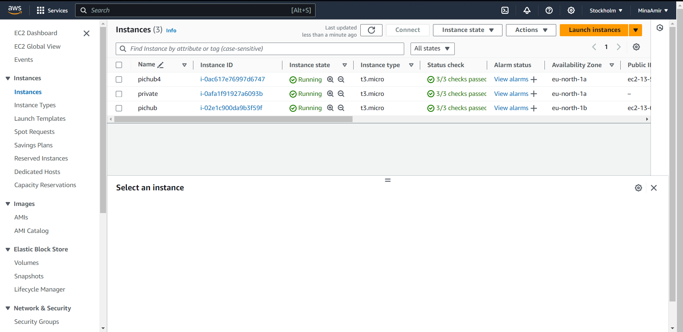
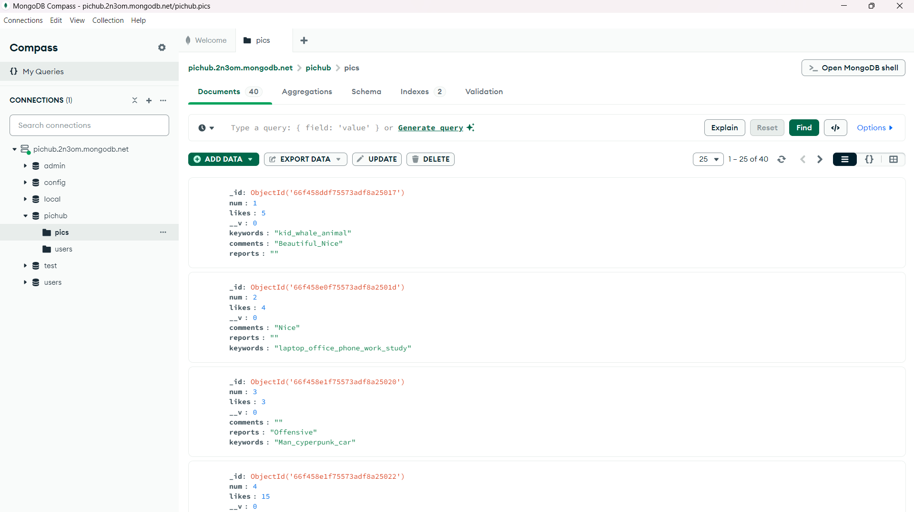
Previous projects
Amazon Web services (AWS)
Mongodb
The server hosting feature
Database service

Slide 14
05
Recommendations

Slide 15
What people say about me
Responsivness
Upload
Improve the responsiveness of the frontend and customize interface for smaller screens
Add upload pictures feature
Image categorizing
Fix errors
Using third-party service for automated image catergorizing
Fixing frontend and backend errors and adding guards and checks

Slide 16
06
Conclusion

Slide 17

PicHub
Although, PicHib is still a project in progress, you still can now visit the website and try out our services and give us feedback to improve>
http://ec2-13-60-85-197.eu-north-1.compute.amazonaws.com:3000/account

Slide 18
Thanks!
Do you have any questions?
minaamir5555@gmail.com
+201124856646
http://ec2-13-60-85-197.eu-north-1.compute.amazonaws.com:3000/

